Slide 1
Predicting Apt Location for Italian Restaurant startup at Hyderabad , India
Suneetha Vanjivakam

Slide 2
Predicting Location for Italian Restaurant startup can be valuable for stakeholders
Generally , preference shall be towards any city centre to start any restaurant , and there are many considerations that route towards that decision.
This Analysis helps decide stakeholders for their Italian restaurant startup location to consider the IT Hub of the city and we show proof towards folium maps about the cluster of location that can be considered .

Slide 3

Data Acquisition and Cleaning
Based on definition of our problem, factors that will influence our decission are:
Number of Italian restaurants in the neighborhood
Distance of neighborhood from city center or IT hub of the City (distance from City center or City IT hub can be preferred for preferred location)
Centres of candidate areas are generated algorithmically using K-means Clustering and plotted using Folium and Heatmaps.
Hyderabad City latitudes and longitudes are obtained using Foursquare API

Slide 4
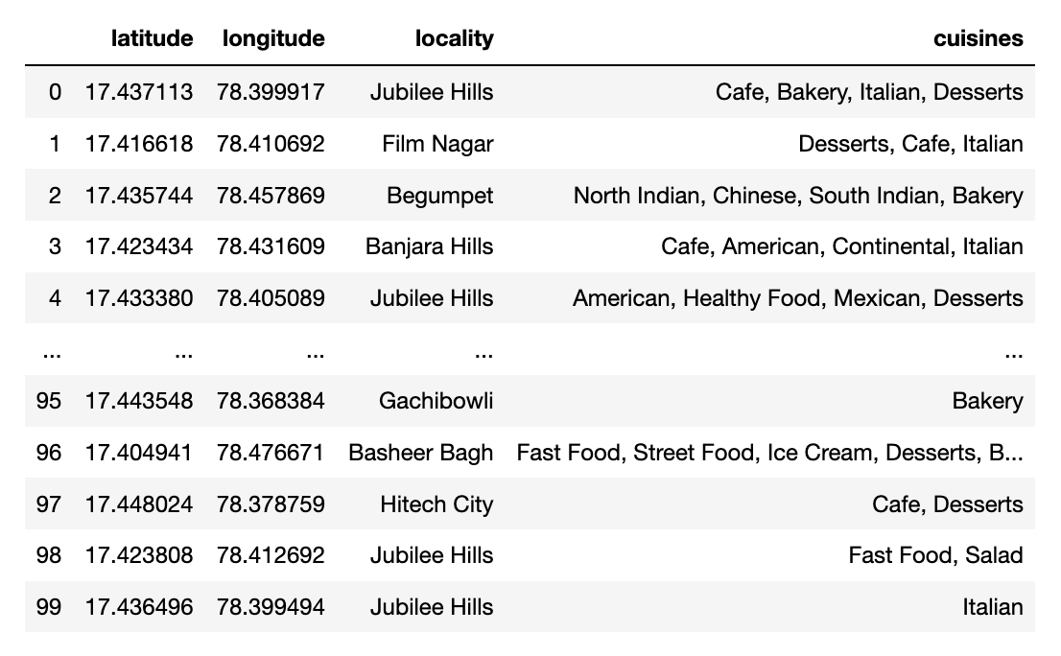
Restaurants Data Frame Details fetched from Zomato API

Slide 5
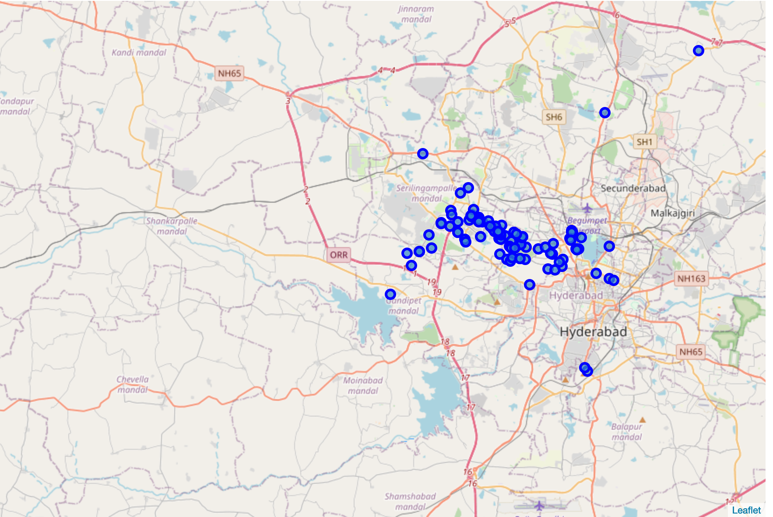
Folium Maps showing the Italian restaurants distribution on map with Hyderabad center

Slide 6
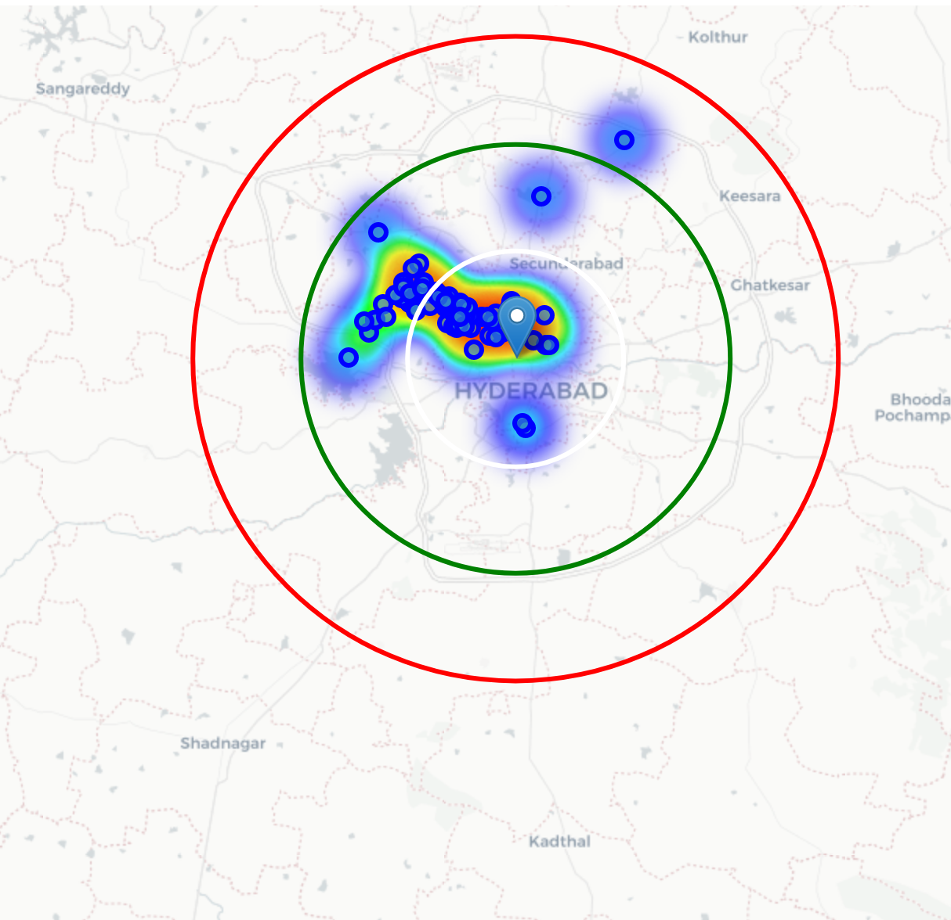
Folium Maps showing the Italian restaurants distribution divided into three regions with 10km , 20km , 30km radius from Hyderabad center
We can see that the core cluster of restaurants are located nearer to city center.
We can consider second region , which can be far from city center , but nearer to IT Hub of the Hyderabad city

Slide 7
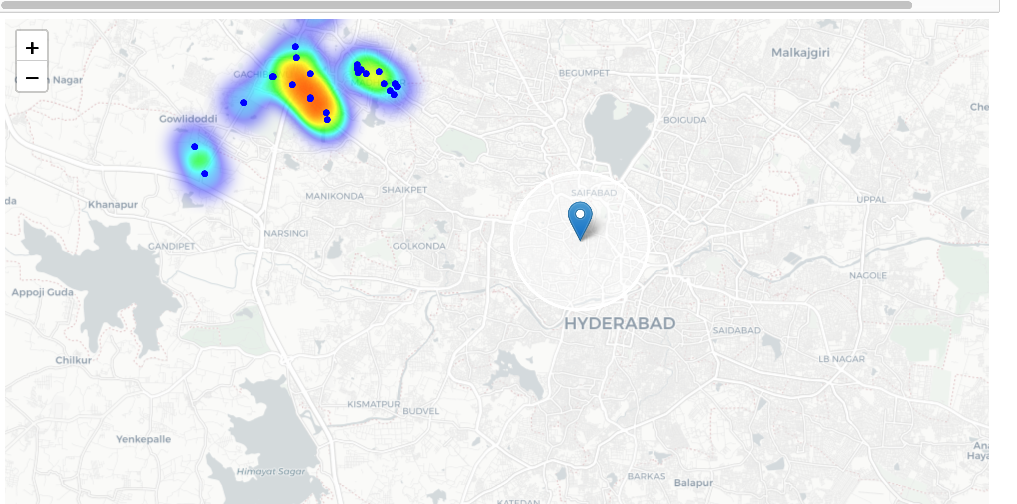
Folium maps showing the Clusters around Hyderabad IT Hub region using K-means clustering algorithm
The map shows that there is one cluster of location around Hyderabad IT Hub , which has only 2 Italian restaurants that can be referred to interested stakeholders .

Slide 8
Conclusions
Observed all the Italian restaurants locations in the city .
Accurate maps are drawn using the restaurant location co-ordinates
Clustering is done for the preferred localities and suggested locality cluster is shown on folium maps.

